Slide 1
Artificial Intelligence
Short Introduction
20 December, 2018
Ajad Chhatkuli¹ and Bishesh Khanal²
1 ETH Zürich, Switzerland; NAAMII, Nepal
2 King’s/Imperial College London, UK; NAAMII, Nepal

Slide 2
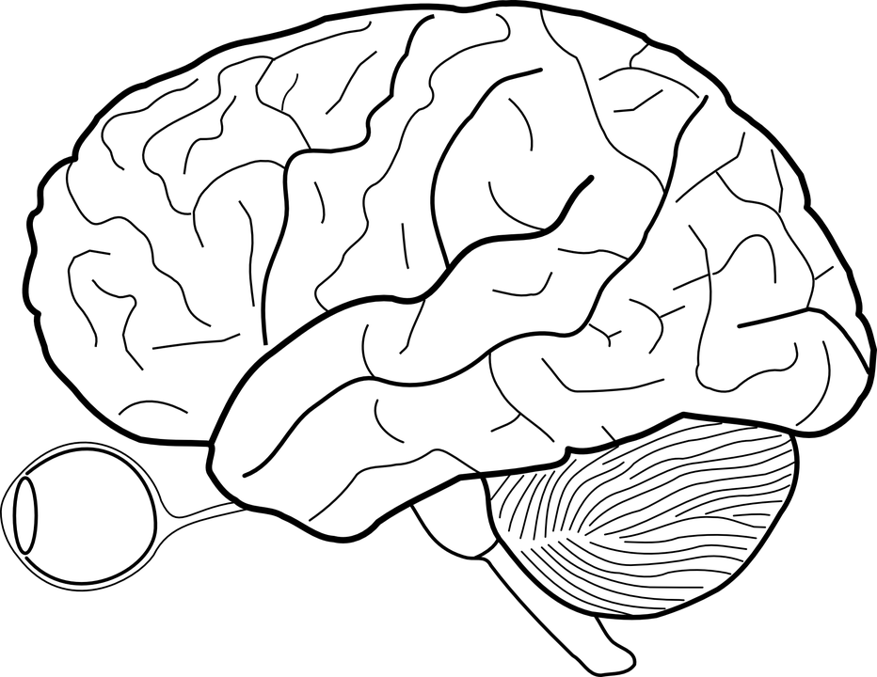
Human Intelligence
Thinking
Consciousness
Imagination
Vision
Language
Balance
Hearing
Touch
Smell/ Taste

Slide 3
Human Intelligence
Emulating this -> Artificial General Intelligence
Thinking
Consciousness
Imagination
Vision
Language
Balance
Hearing
Touch
Smell/ Taste

Slide 4
Artificial Intelligence
Ability of man-made agents to do tasks traditionally attributed to “intelligence” of some level

Slide 5
General Intelligence
Sense
Decision
Action

Slide 6


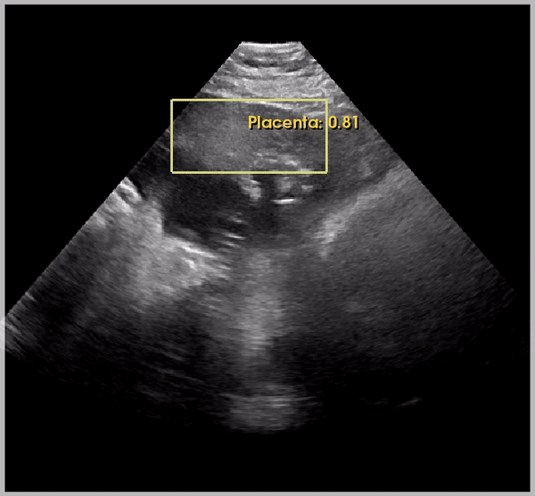
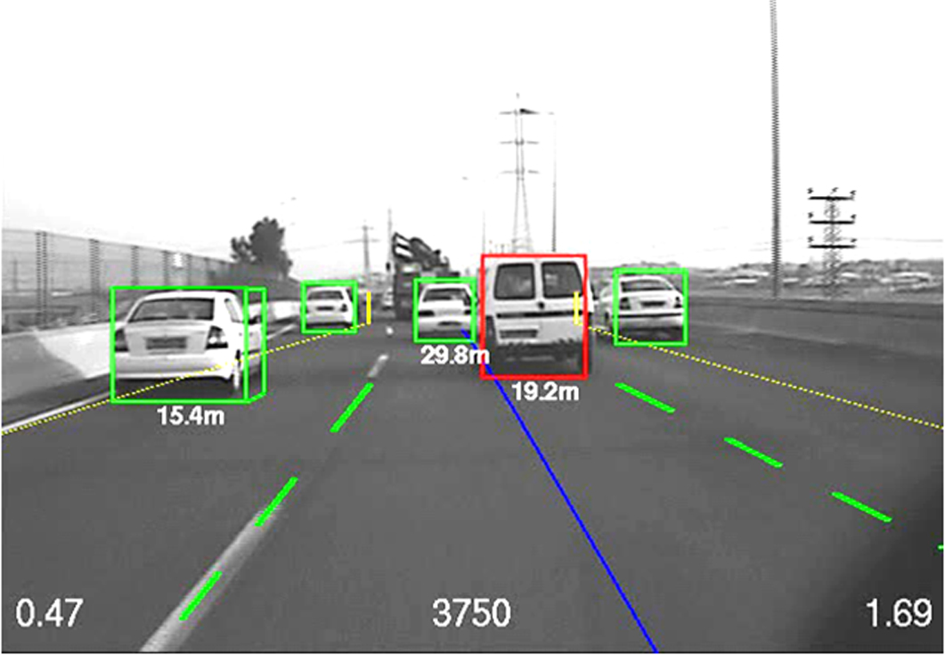
Mobileye system for autonomous driving

Slide 7
Mobileye system for autonomous driving

Slide 8
Vision
It’s not just about the eye, the mere sensor
Human Vision is done in the brain!

Slide 9
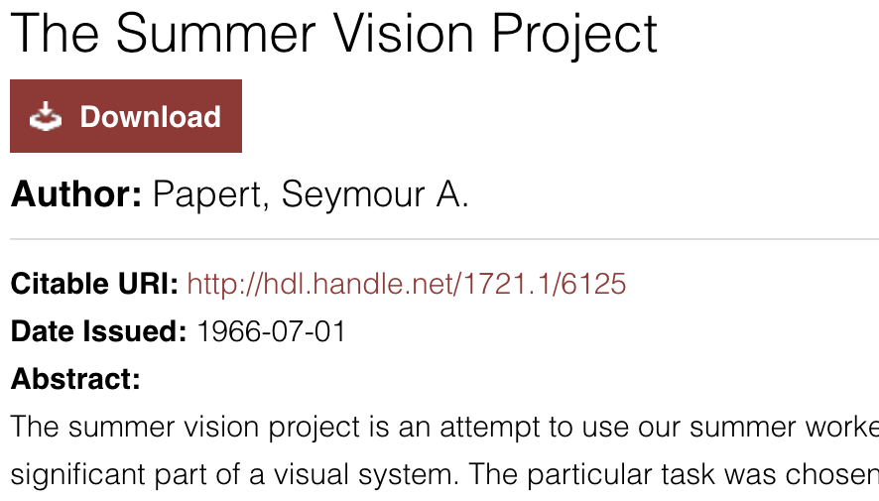
Artificial Intelligence for Vision
Pattern Recognition
objects
construct a system of programs
background areas and chaos
Object Identification

Slide 10
Artificial Intelligence for Vision
Pattern Recognition
objects
construct a system of programs
background areas and chaos
Object Identification
Still an open problem, after > 50 years!!

Slide 11


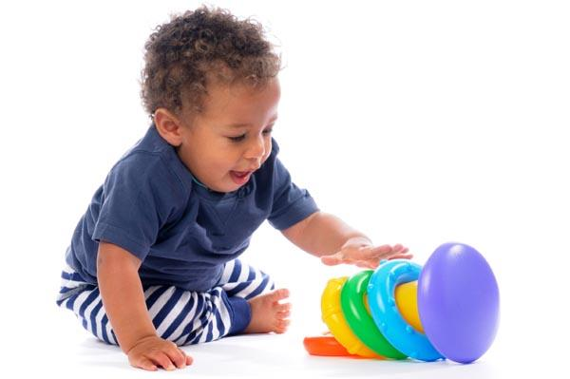
How do we learn to see ?
We move in order to see and see in order to move- William Gibson
We live in a 3D world
source: Traveltourtrek Nepal
Three pillars of AI - data, learning and knowledge
-Fei Fei Li
Linear Algebra

Slide 12
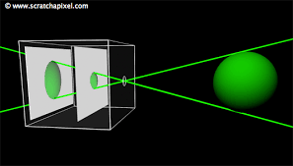
Camera images are 2D

Slide 13



3D Modeling from 2D Images
Automatically compute 3D model from images

Slide 14
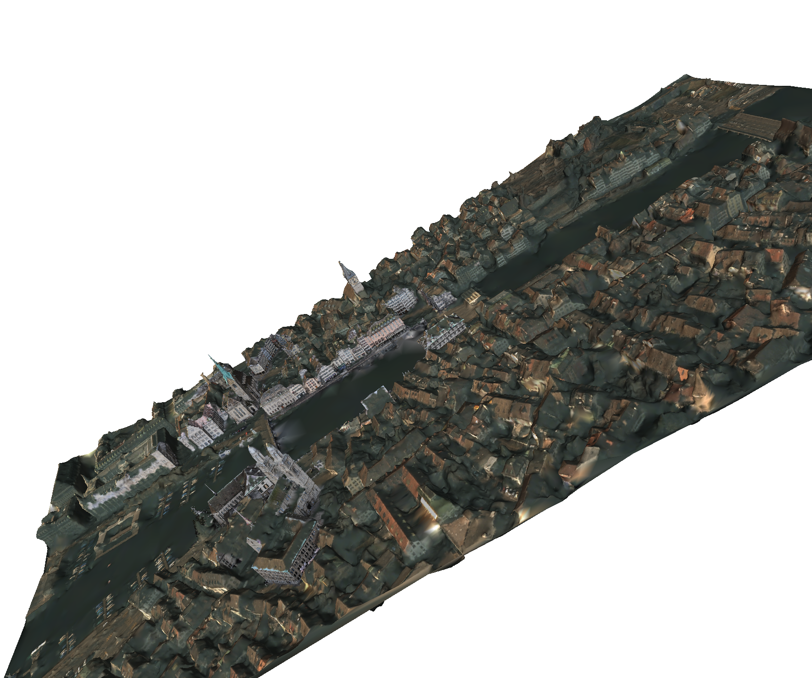
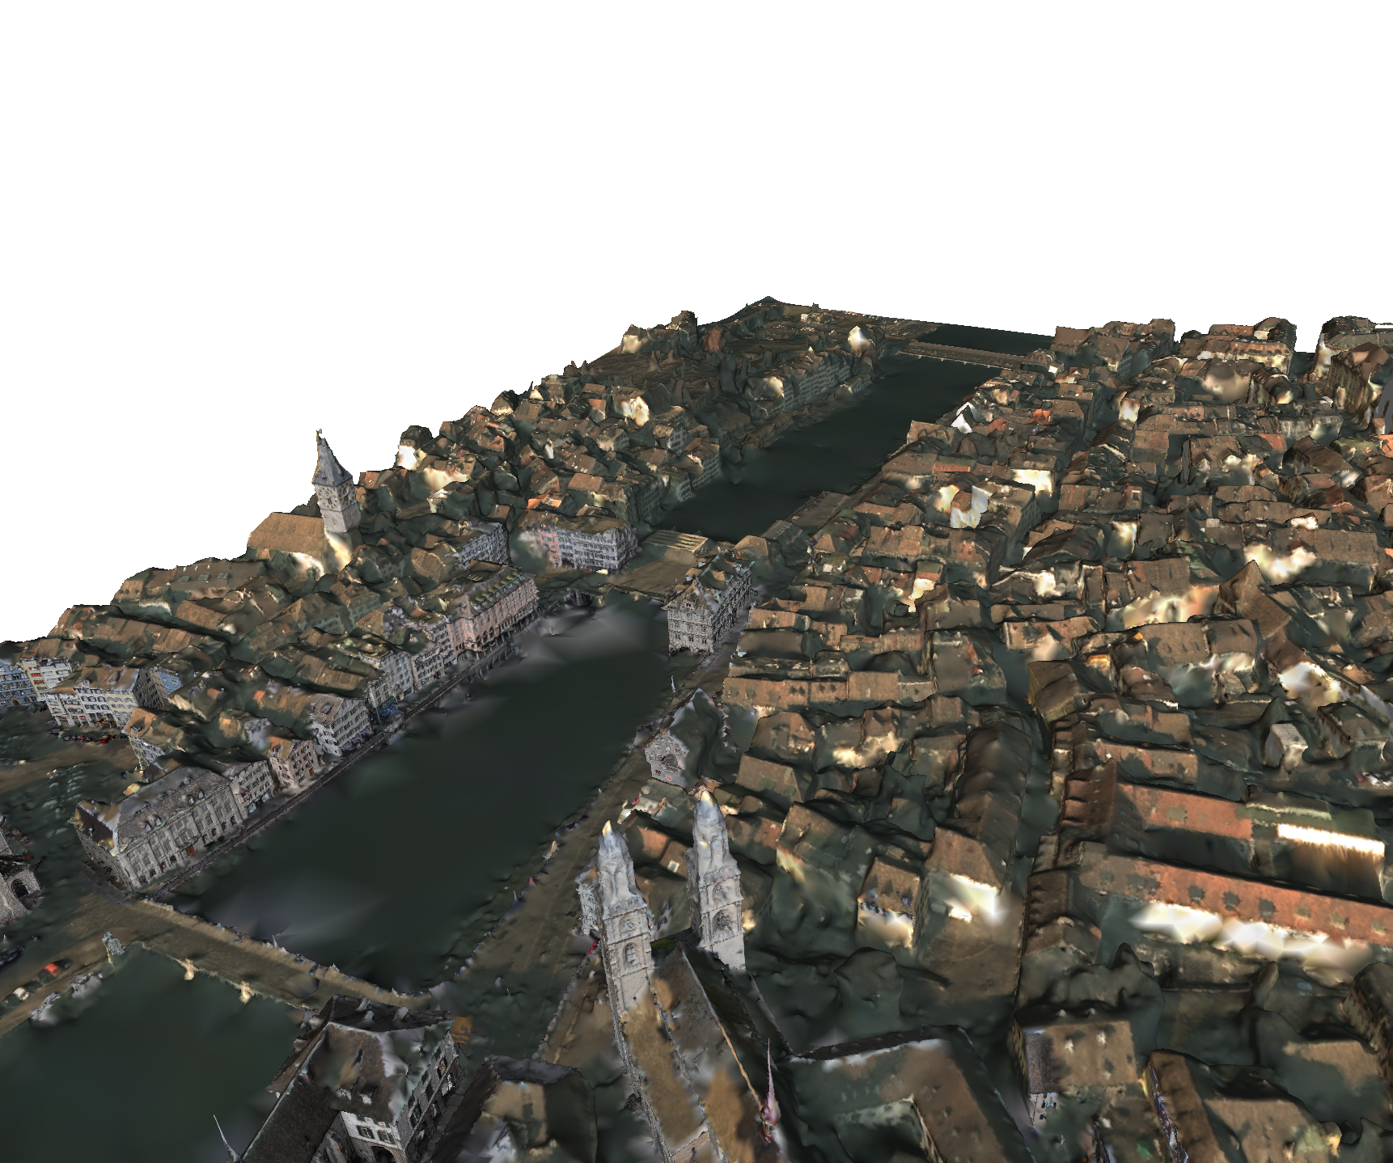
3D Modeling from 2D Images
Automatically compute 3D model from images
3D Model of a part of Zurich modeled from images – source VarCity, CVL –ETH Zurich

Slide 15
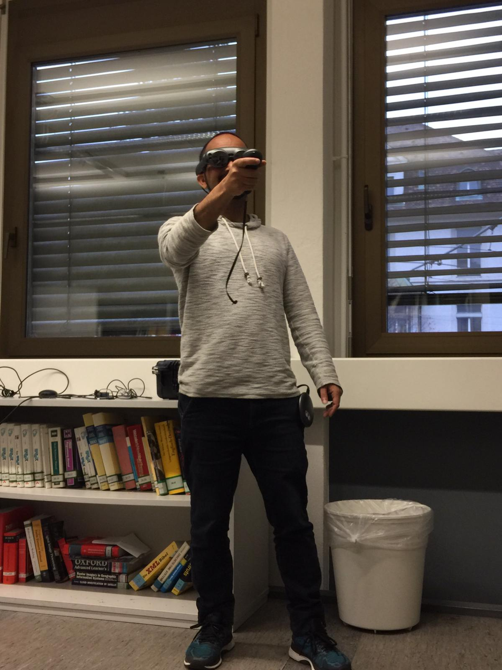
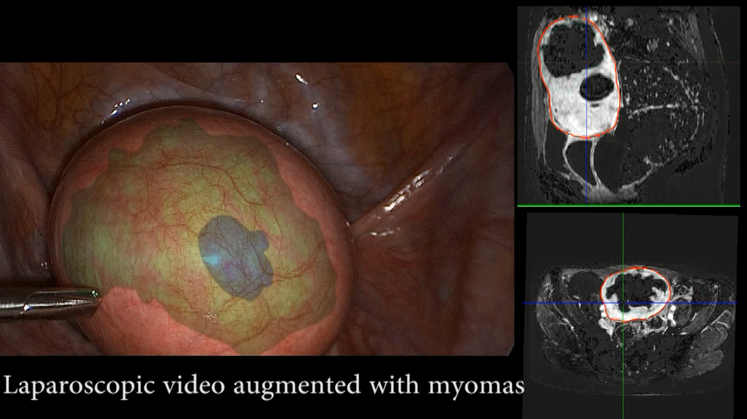
Applications of 3D vision
Mixed Reality and Virtual Reality
MagicLeap demo
ENCoV - France

Slide 16
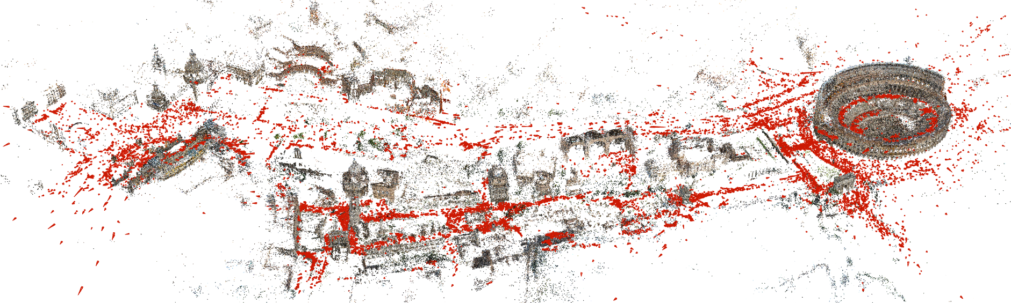
How?
Linear algebra and multi-view geometry
Intermediate state of 3D modeling from images of a part of Rome – source: COLMAP

Slide 17

Linear Algebra
Solve linear equations!
Efficiency, shortcuts, etc.
Analyze linear functions
Properties, zeros, etc.
Vector space properties

Slide 18
History
Linear algebra
~2000 BCE – Babylon : linear equations of 2X2 systems
~200 BC – China : “Nine Chapters of the Mathematical Art” 3X3 systems
Generalized after the 17th century: works of Cramer, Leibnitz, Gauss.
Matrix notation: Sylvester (1848), Cayley (1855). Determinants and Transformations.
Source: [Christensen, 2012]

Slide 19
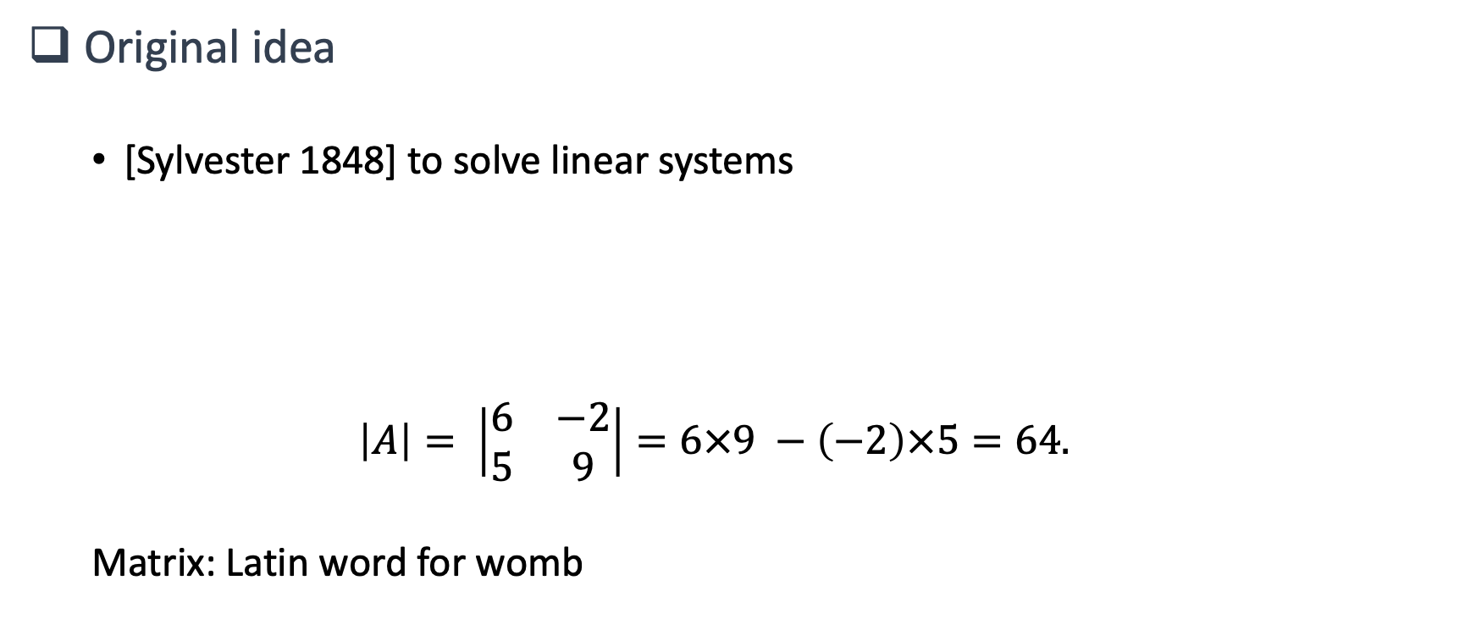
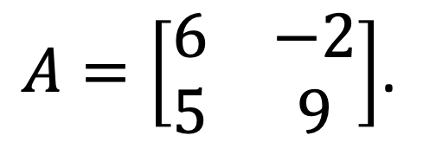
The Matrix

Slide 20
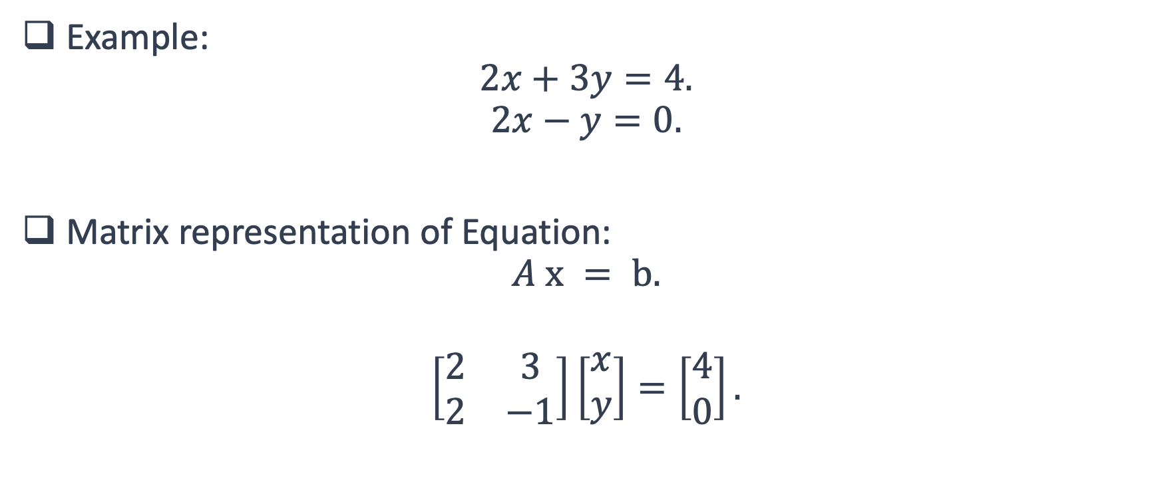
Matrix in Linear Equations

Slide 21
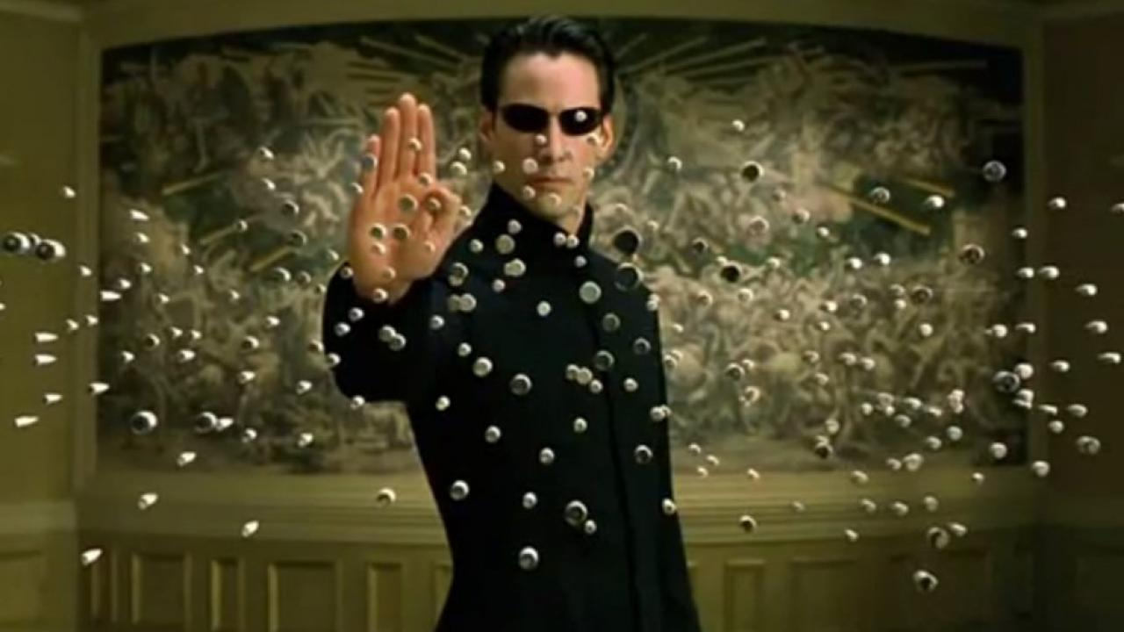
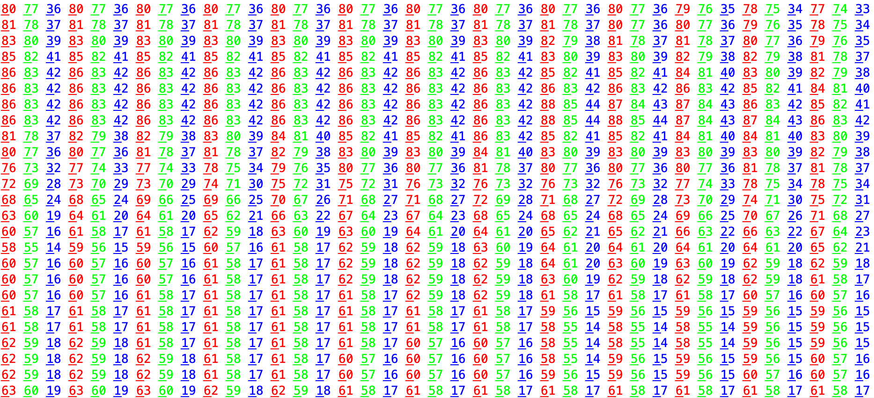
Matrix
Powerful way of Representation
Ordered arrays of Numbers
Data/Information such as Images, Videos, Sounds, etc.
Can represent so many things!!

Slide 22
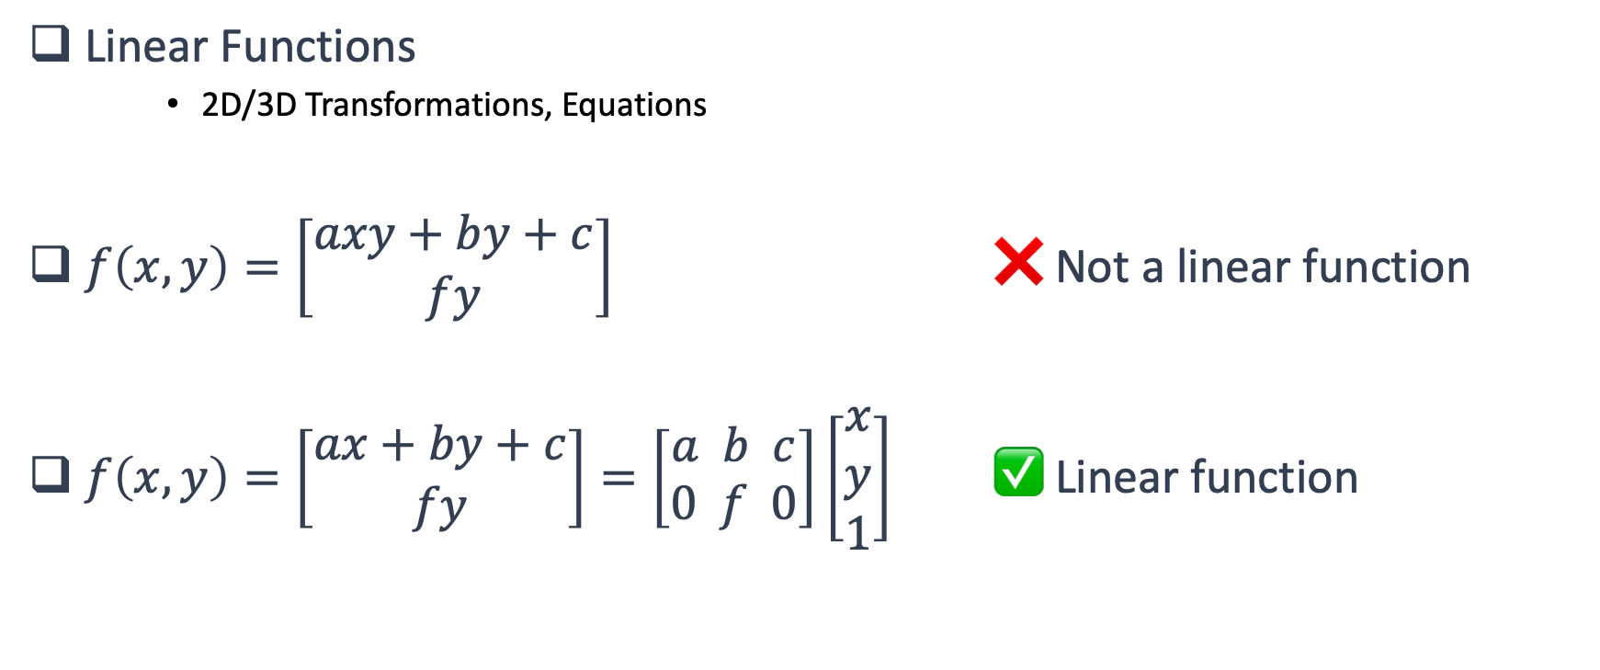
Matrix in Mathematics
Matrix represents linear functions of vector!

Slide 23
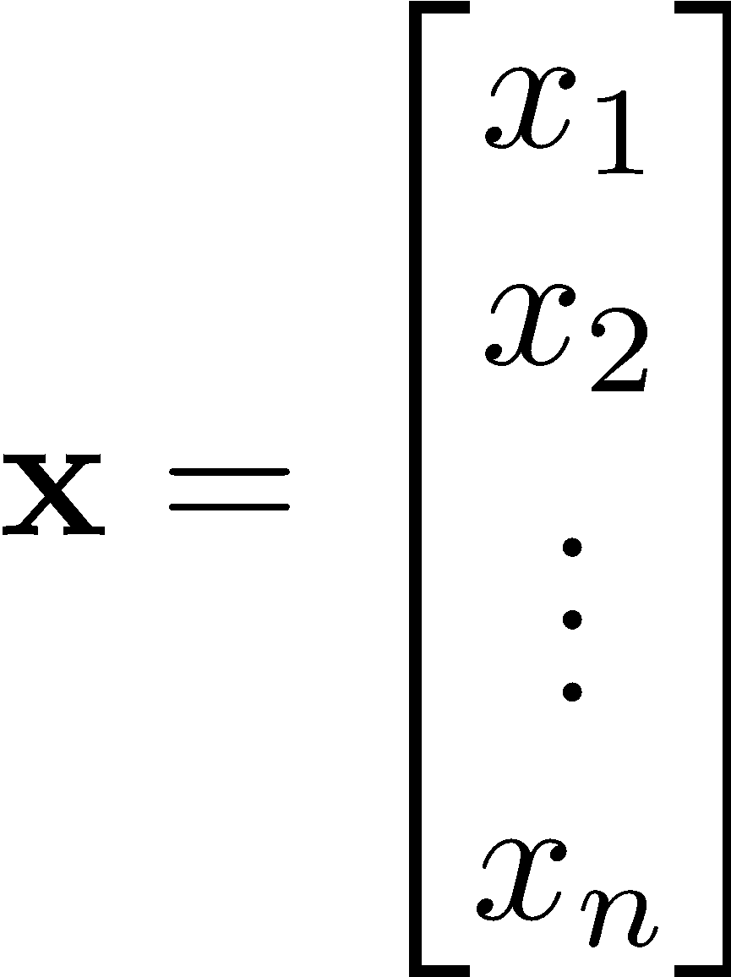
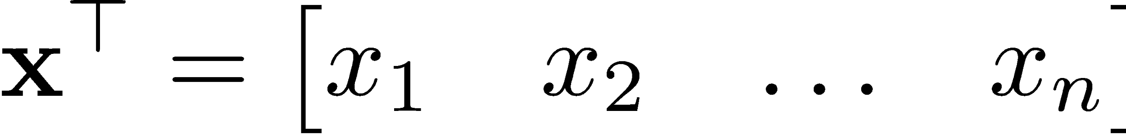

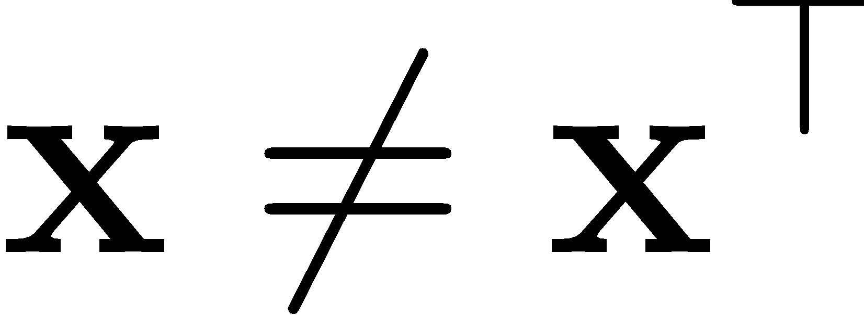
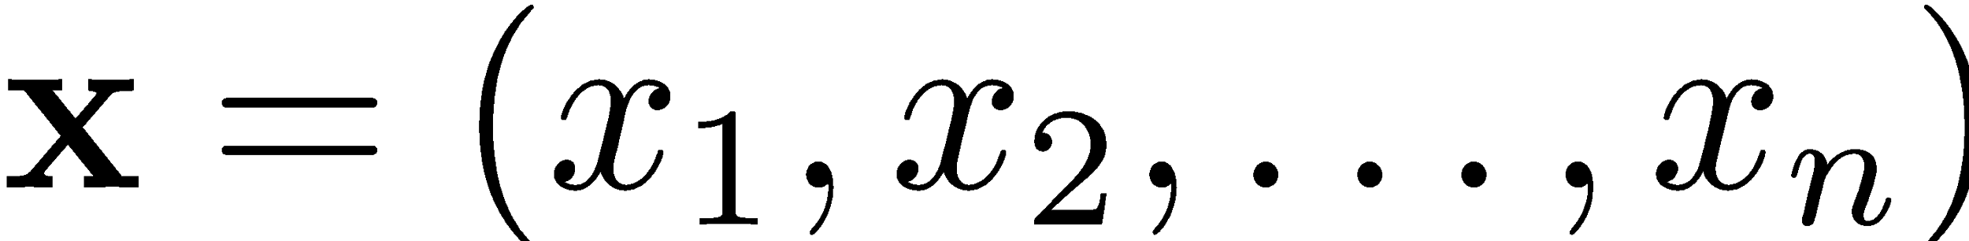

Vectors - notations
Column vectors and transpose
Note: Vectors have components, order matters

Slide 24
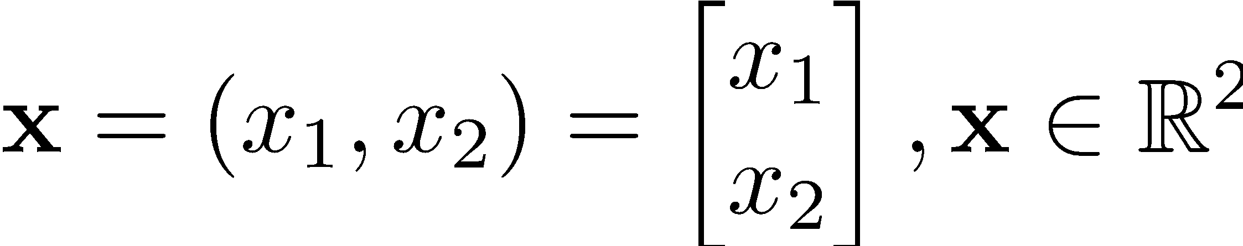
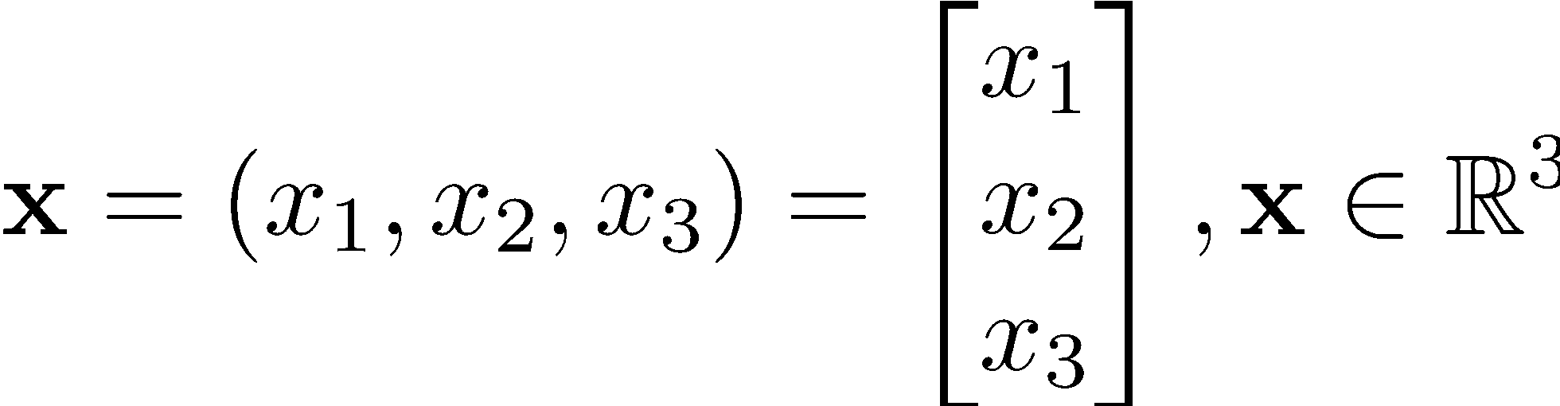
2D and 3D vectors

Slide 25



Combining vectors: Linear combination
Addition
Scalar multiplication
Linear combination

Slide 26

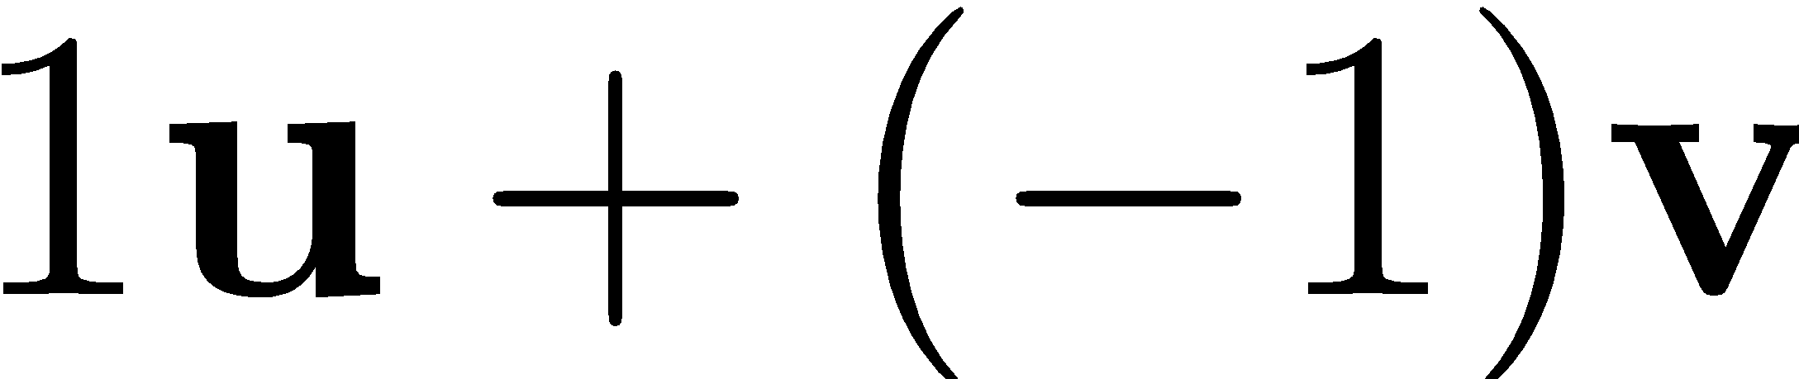
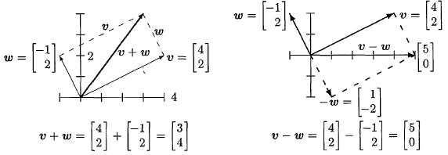

Linear combinations
Some special combinations:
Sum of vectors :
Difference of vectors:
Zero combination:
Scaled vector:
If you combine “enough” vectors,
you can represent any vector

Slide 27

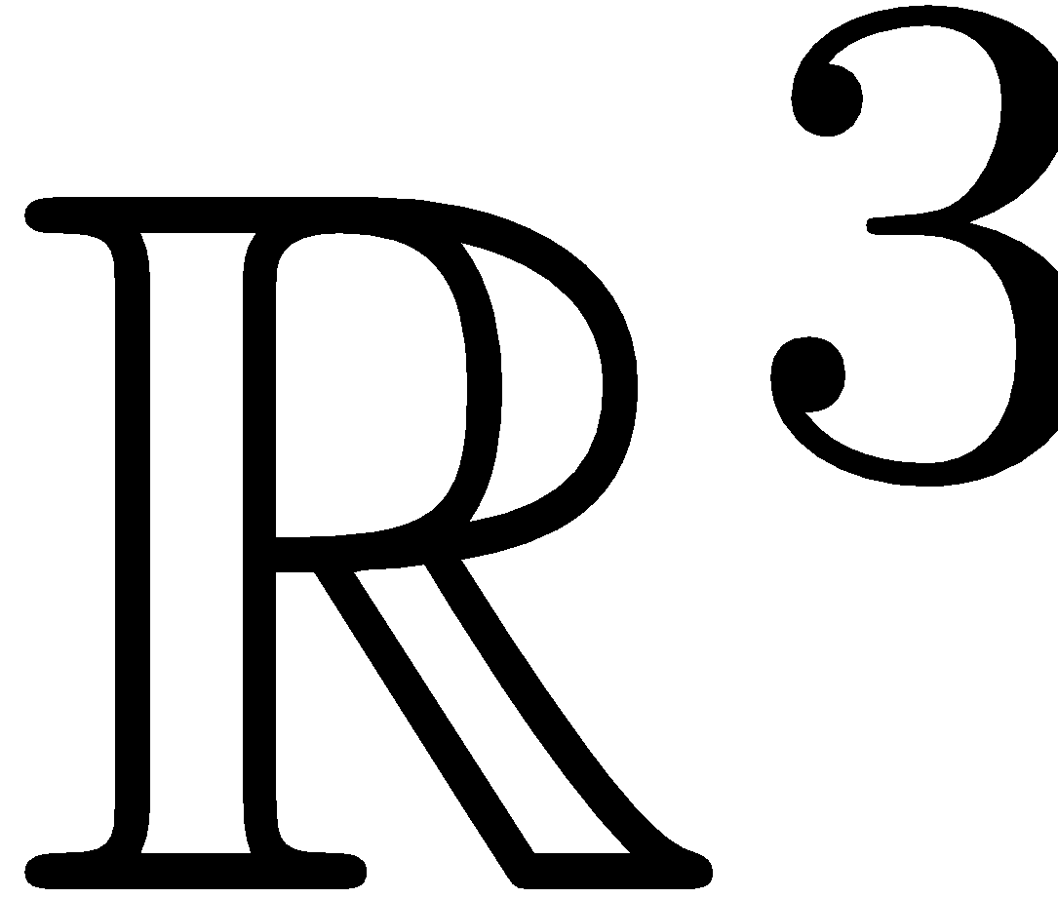

Linear Combinations fill spaces
Different number of vectors fill different spaces
are 3-vectors, i.e., members of

Slide 28
Linear Combinations fill spaces
Different number of vectors fill different spaces
are 3-vectors, i.e., members of
fill a line
fill a plane
fill the whole set of

Slide 29
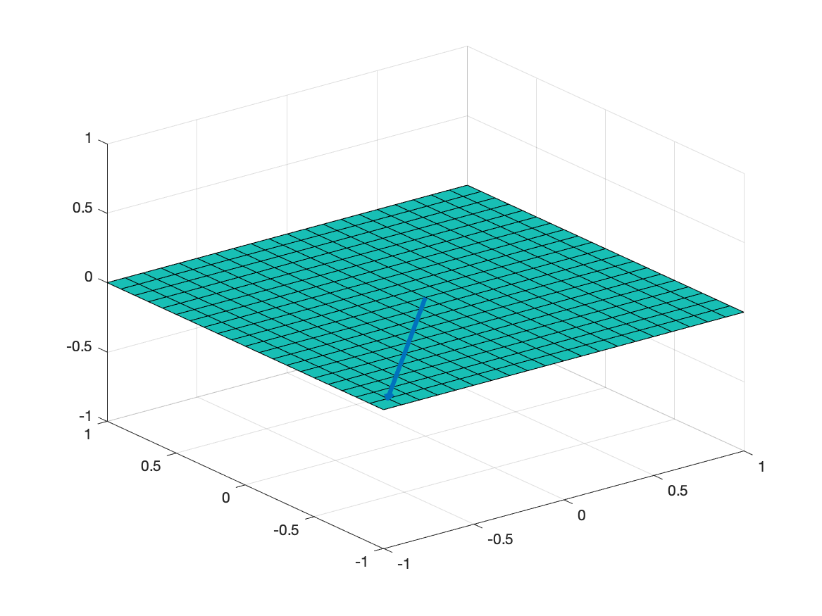
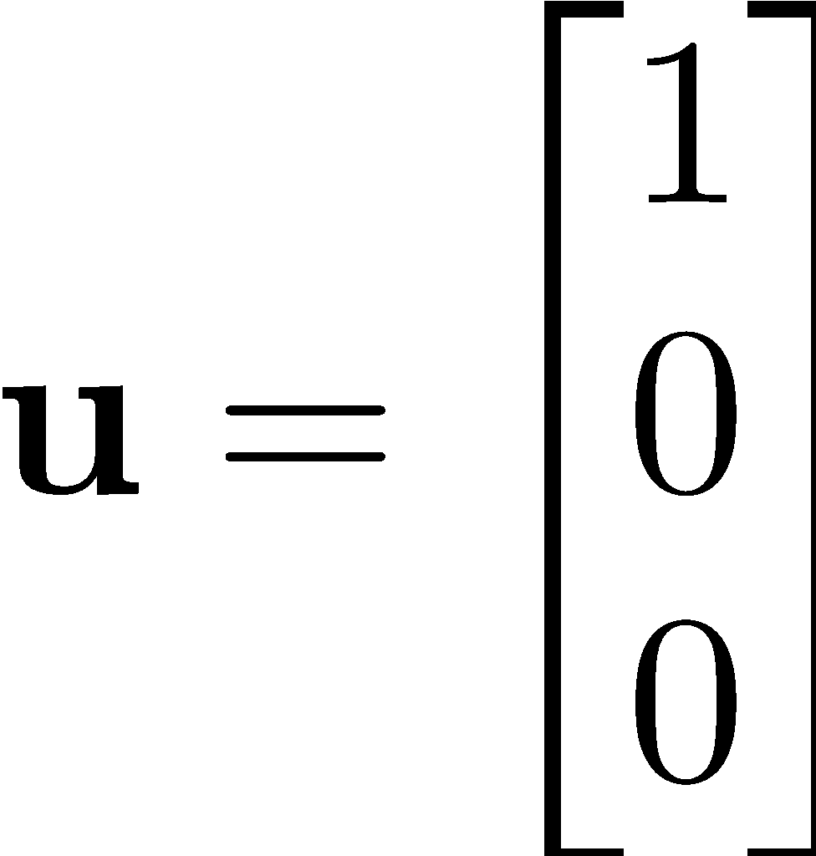
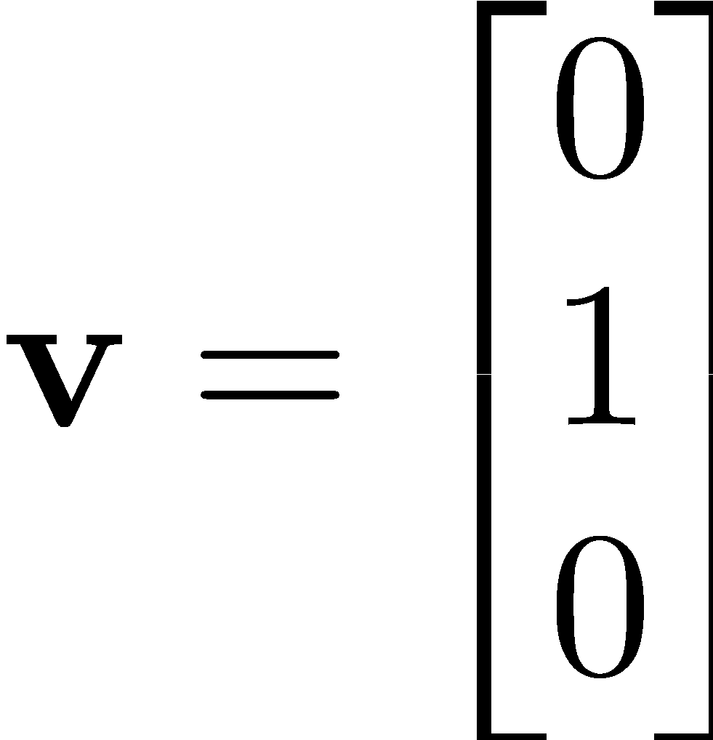


Linear Combinations Examples
Combinations to represent any vector
All combinations of

Slide 30
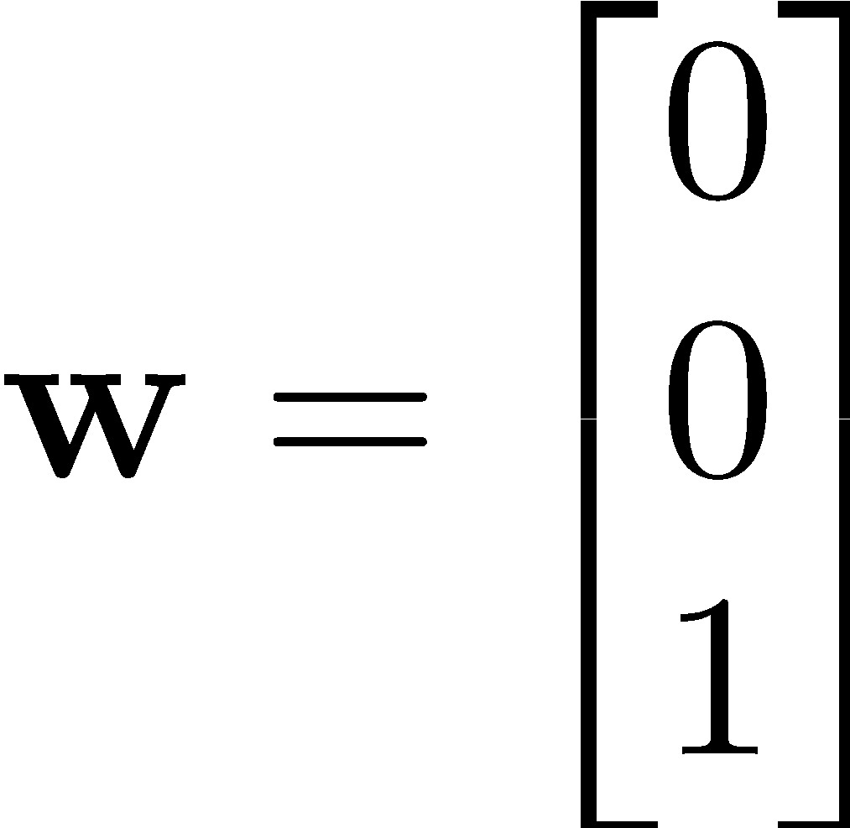
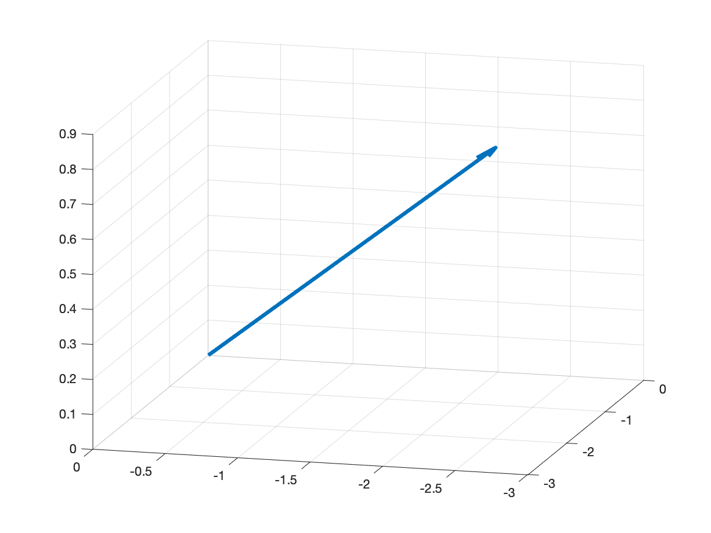
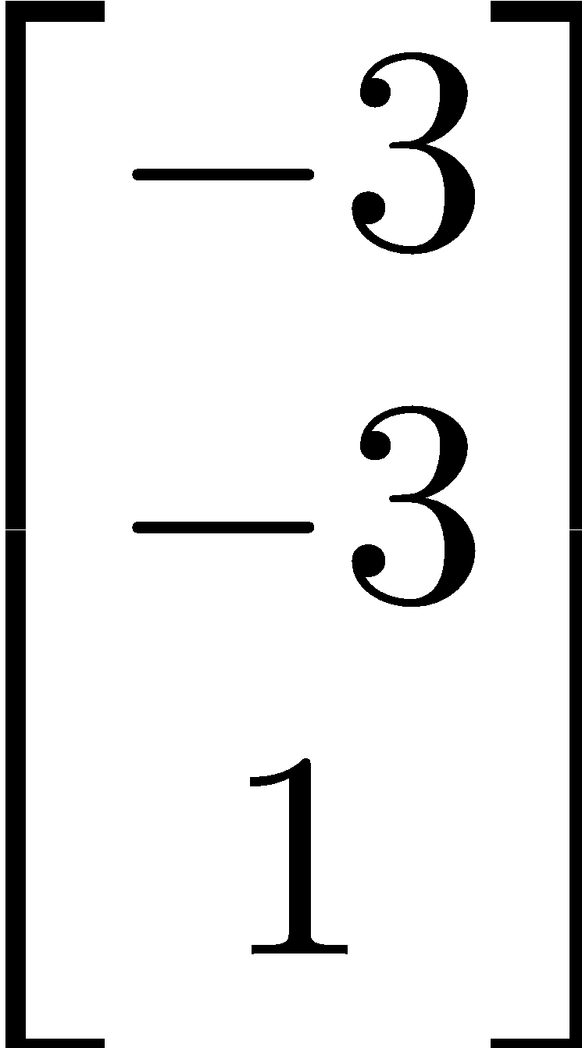
Linear Combinations Examples
Example: Find the coefficients.
All combinations of
spans

Slide 31
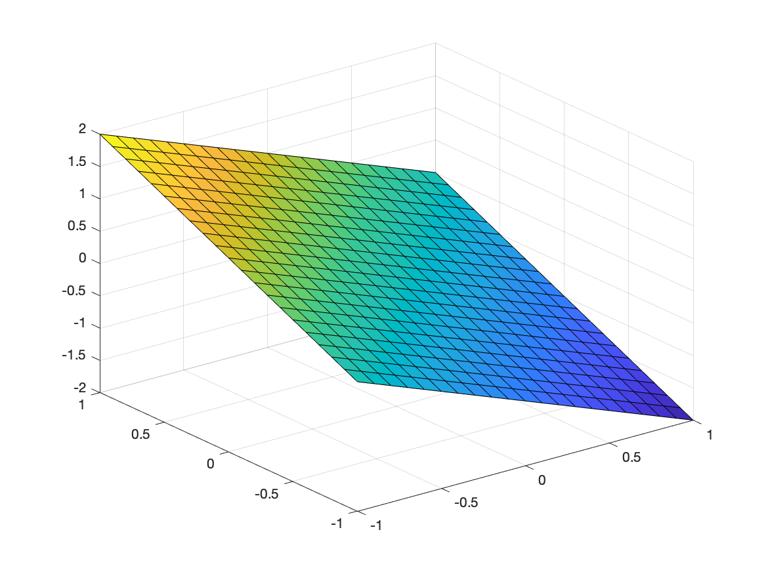
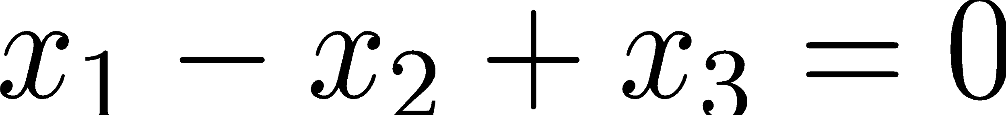
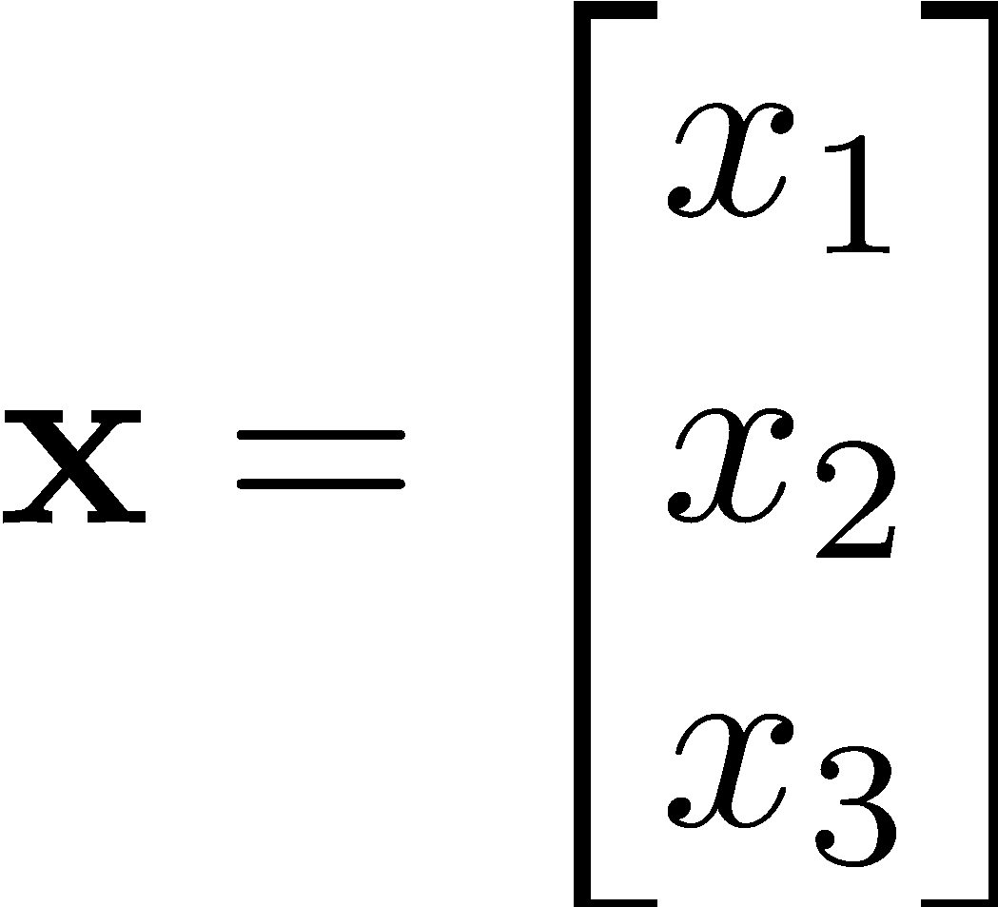

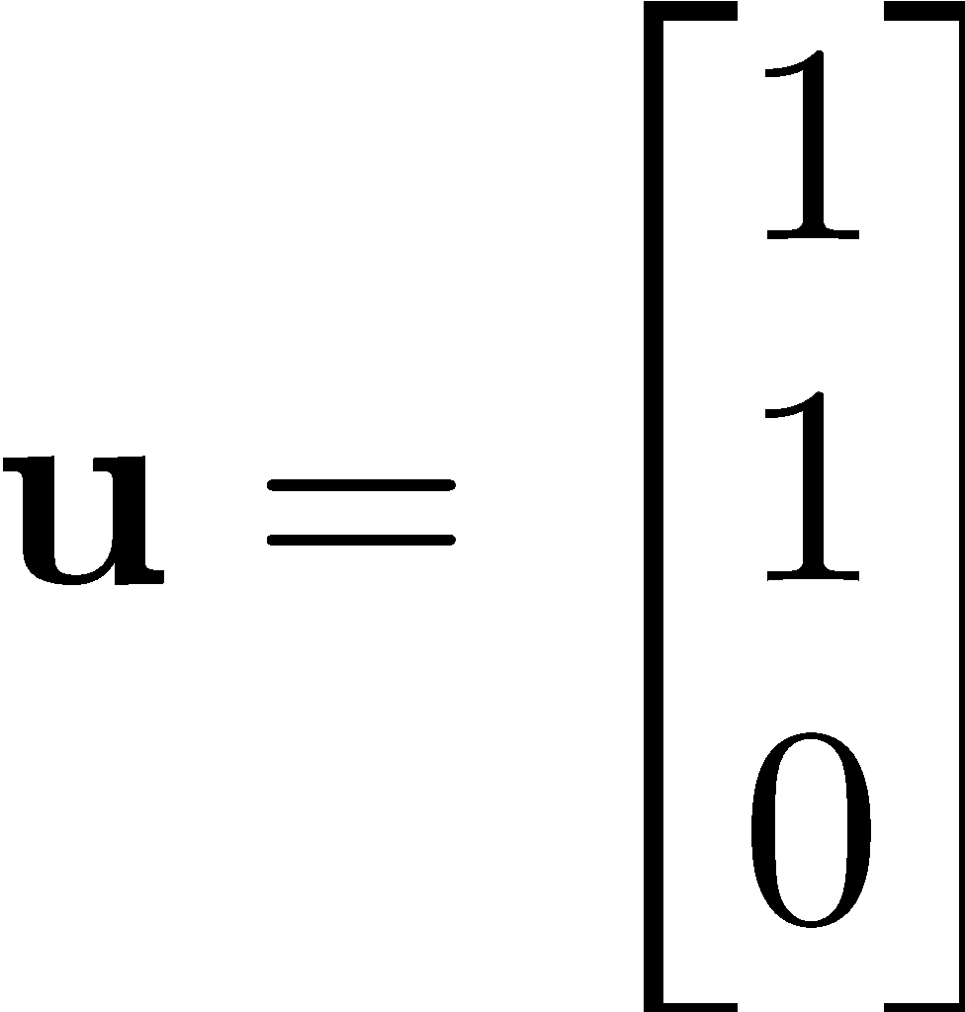
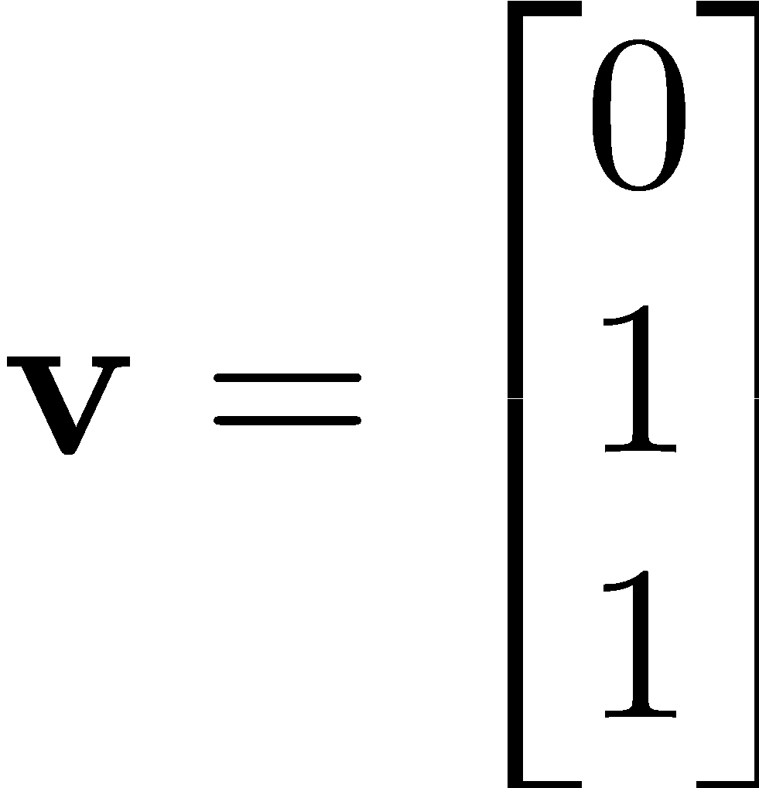

Linear Combinations Examples
Example:
How do you fill the following plane:
spans
Notes:
u = [1 1 0] , v = [ 0 1 1]

Slide 32
Vectors and Linear Dependence
Vectors are linearly independent if,
Only for

Slide 33
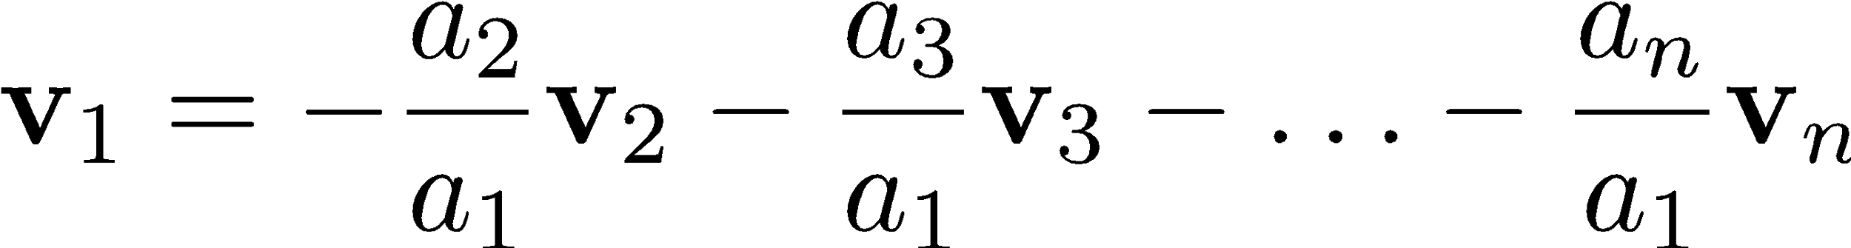
Vectors and Linear Dependence
Vectors are linearly dependent if,
Any of the vector is a linear combination of the others.
e.g.,
For at least some non-zero coefficients.

Slide 34
Vector Spaces
“Vector spaces are closed under linear combinations”
Special sets of vectors
Linear combinations of vector space elements are always in the same space

Slide 35


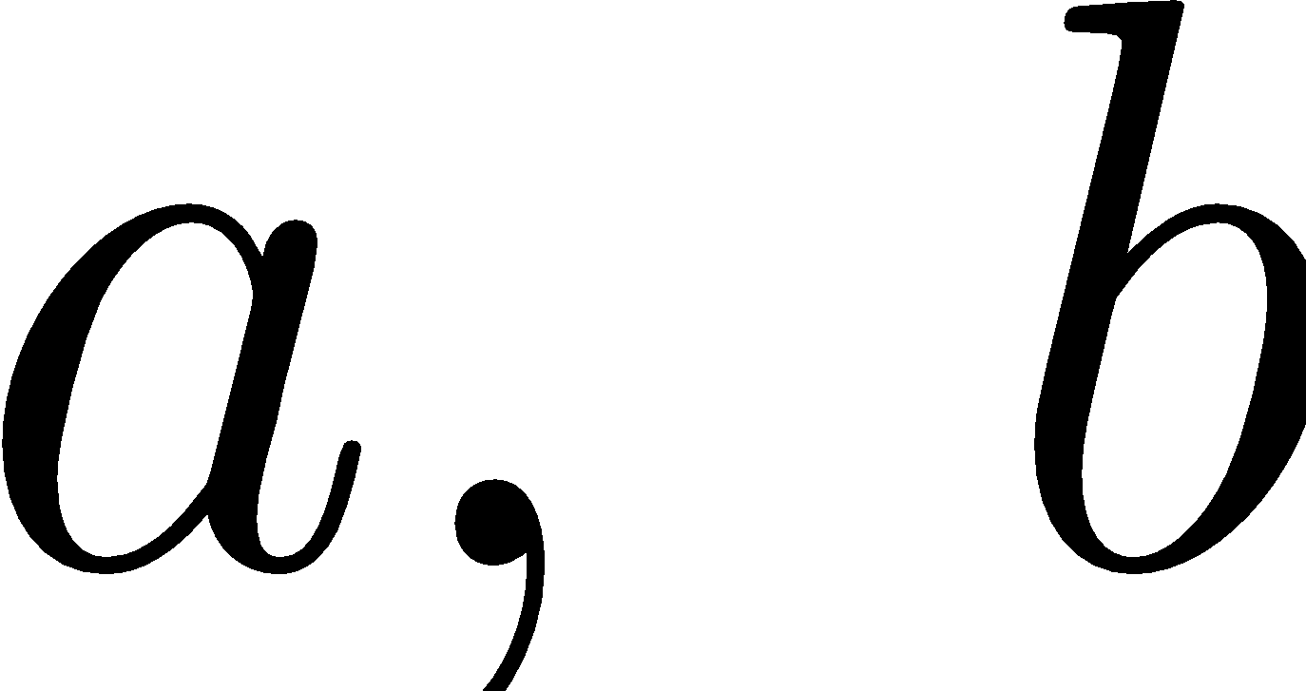
Properties of Vector Space
If
For all values of the coefficients
Is the 0 vector always in a vector space?
Yes

Slide 36
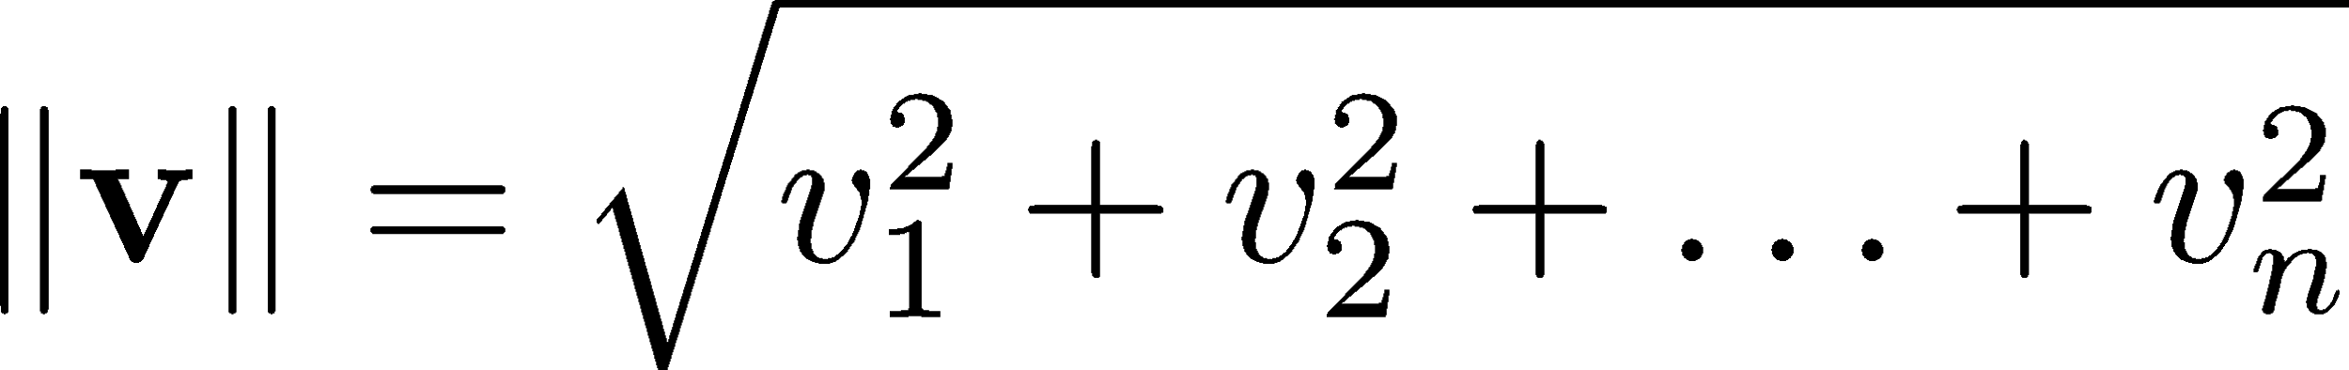
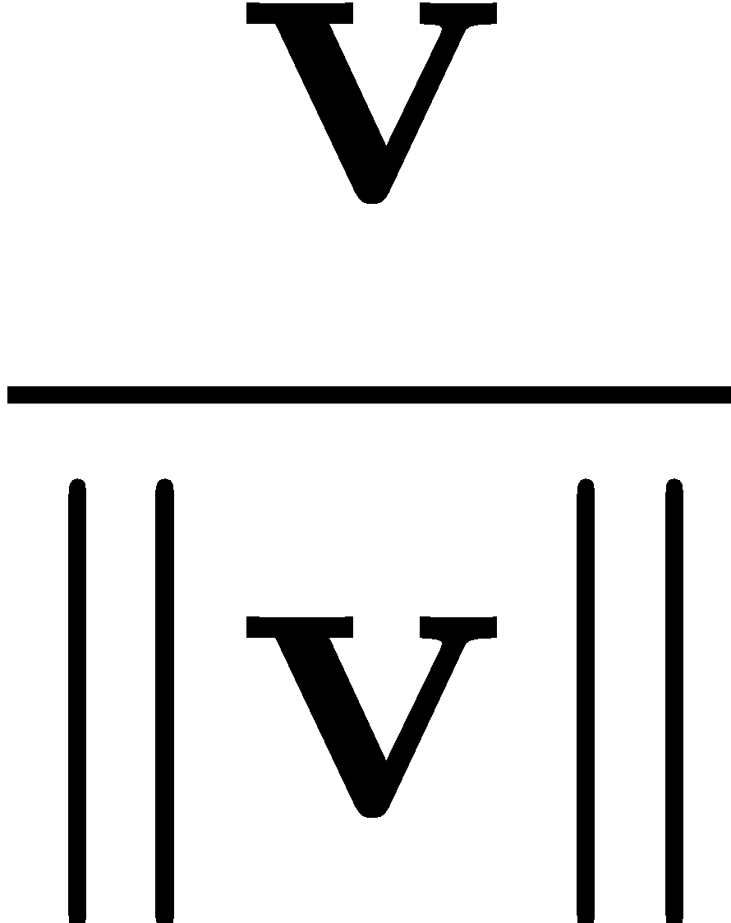

More of vectors
Vector norm
Unit vector
Magnitude or length
is a unit vector for any non-zero vector

Slide 37
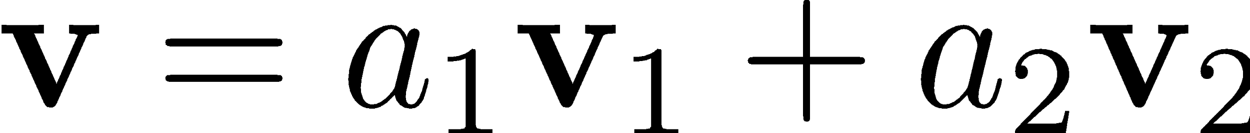



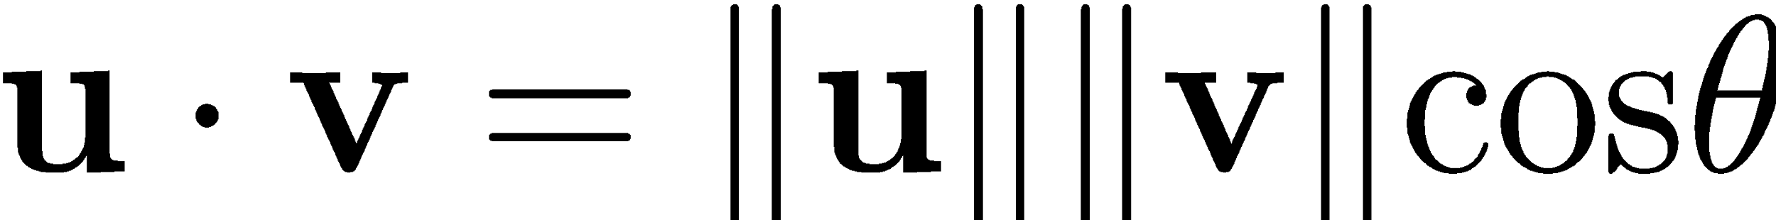
Vector Operations
Linear Combination
Dot Product

Slide 38
Vector Operations
Cross Product* - only for vectors in

Slide 39
Orthogonality
Consider n orthogonal vectors in a vector space
Orthogonality implies:

Slide 40
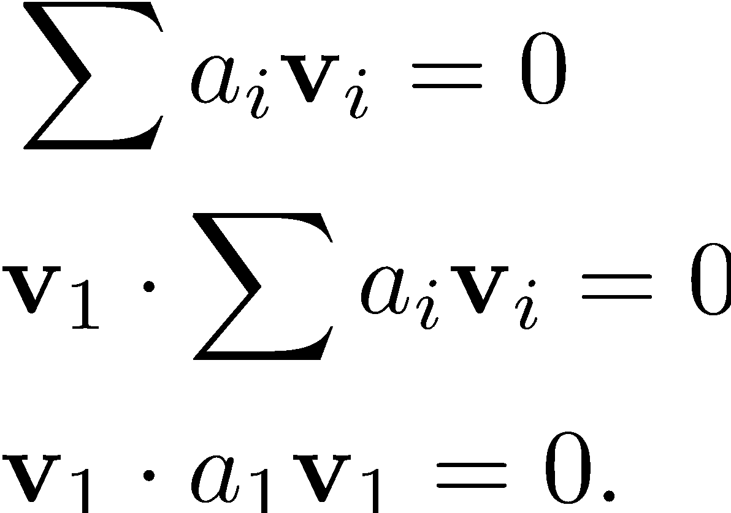
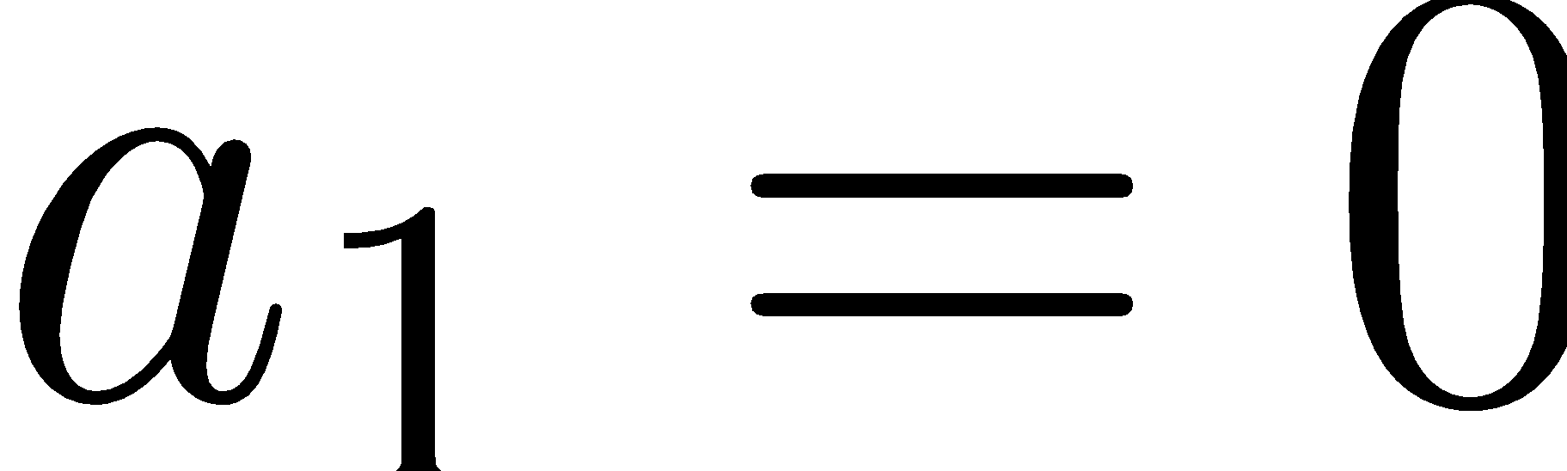
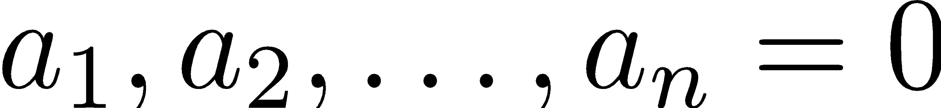
Orthogonality
Can you prove that they are independent?
Repeat the dot products with others!

Slide 41
Vectors and Sets
A few things to keep in mind:
Vectors -> Ordered components
Sets -> Elements have no specific order
Consider R2: X-Y coordinate system (0,1), (1,0)

Slide 42
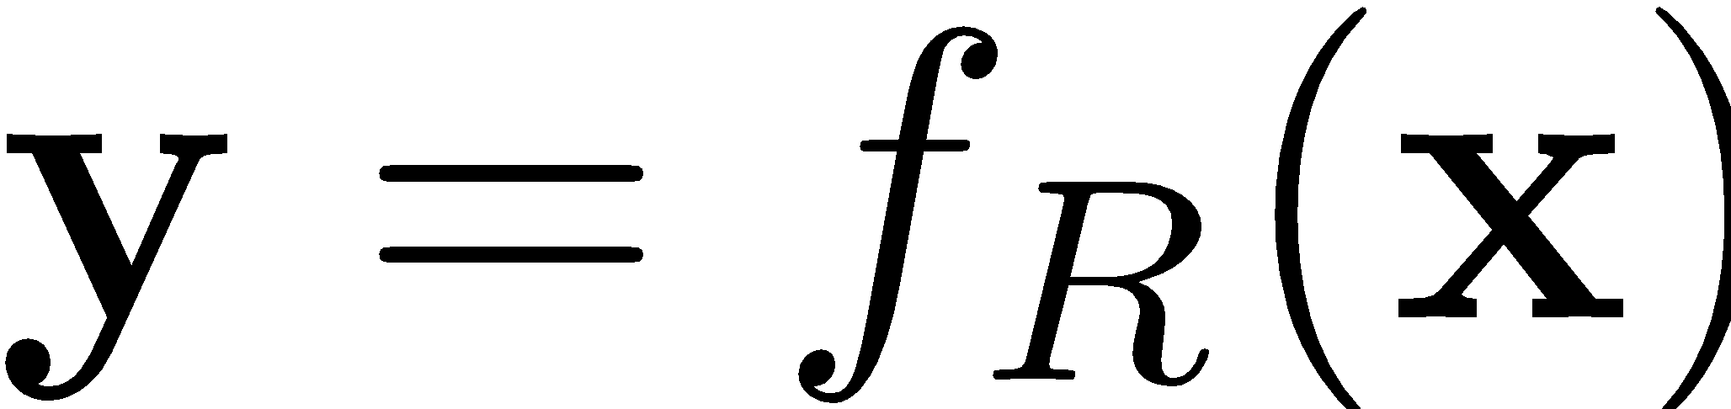
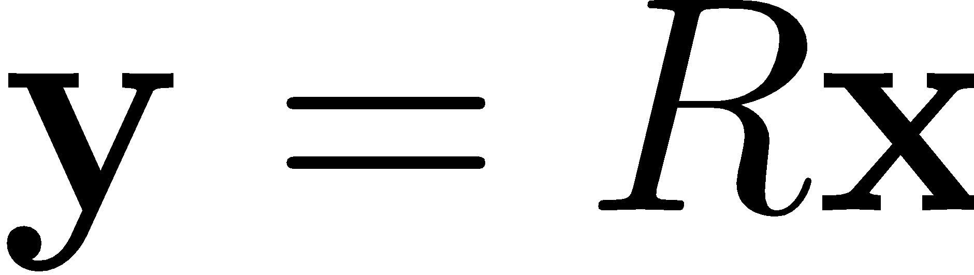
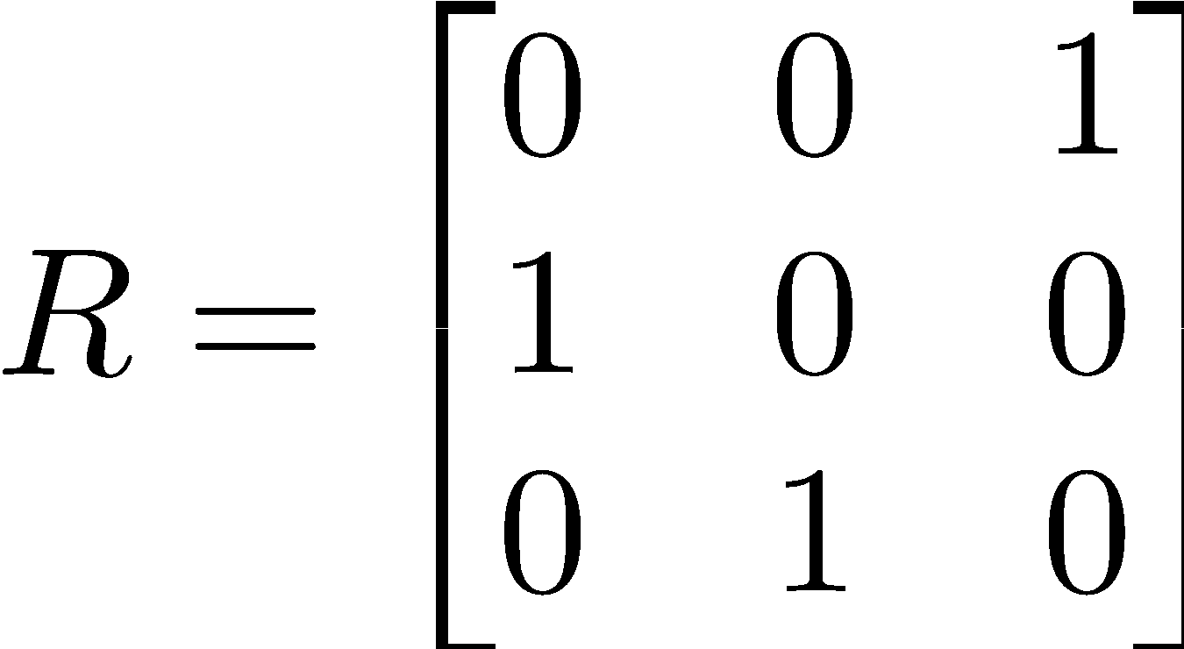
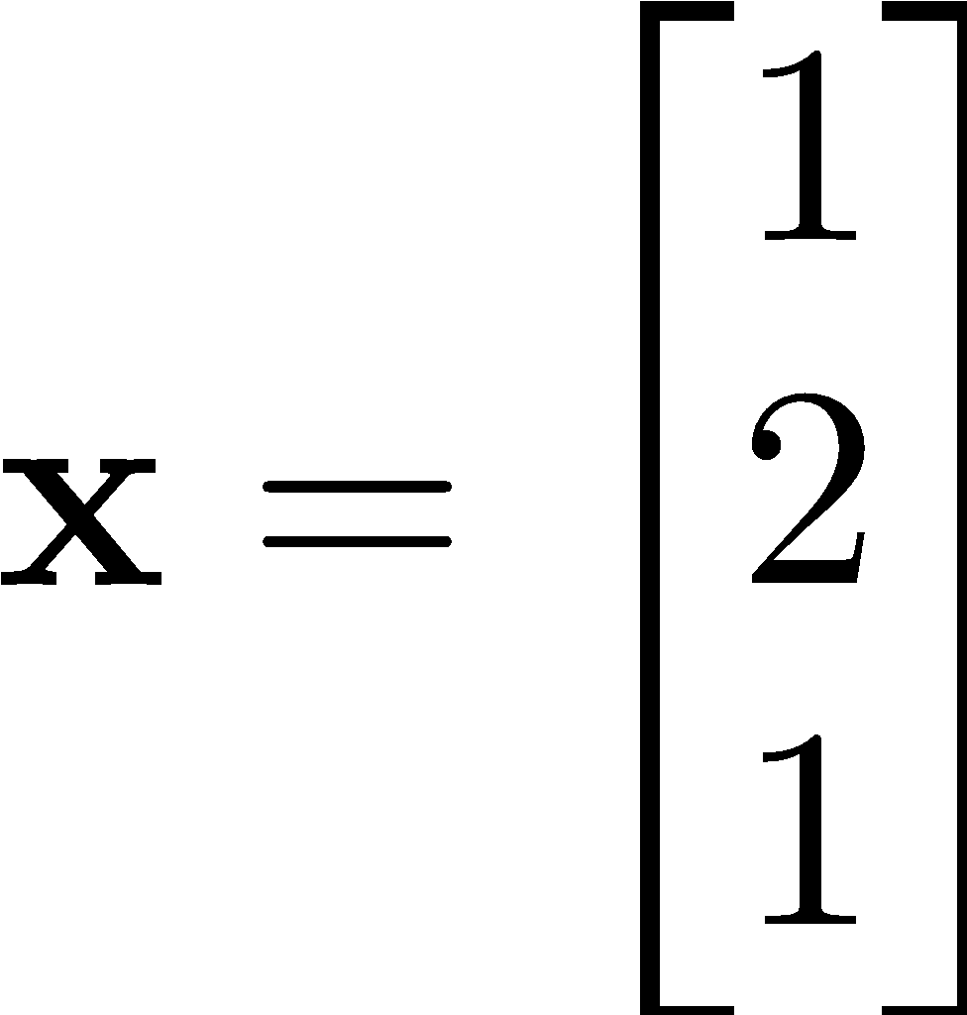
Matrix as Transformations
Example: Rotation

Slide 43



Function how?
Input (vector) -> Transformation Function (Matrix) -> Output (vector)
Notes:
Blue – input, red - output

Slide 44


Matrix Multiplication
[Cayley, 1850], [Cayley, 1855]
Product of matrices: Composition of linear functions
Composition of one rotation after another

Slide 45



Matrix Multiplication
Example
Consider the following transformation:
Notes:
Blue - input, green -> intermediate after R1, red -> final output

Slide 46



Matrix Product as Linear Combination
In linear algebra, we interpret products as linear combinations

Slide 47

Matrix Product as Linear Combination
In linear algebra, we interpret products as linear combinations
Column Vectors of the matrix

Slide 48


Solving Equations
Compute examples:
Simple Rotation in 3D:
Solve for the vector:

Slide 49
Solving Equations
Linear function approach:

Slide 50


Solving Equations: Inverse problem
Linear function approach:
Compute the inverse function
When is not invertible?

Slide 51
Recall: Vector Spaces
Define: Basis of a vector Space:
Set of independent vectors that span the vector space.
Quiz: Can the 0 vector be in the basis?

Slide 52



Matrix Spaces
Columns of the matrix
Space spanned by the linear combinations of
How many of them are independent?
Column Space
Dimension of the space

Slide 53




Matrix Spaces
What is the rank?

Slide 54


Matrix Spaces
A few theorems on rank
Matrix:
Rank is not more than the smaller dimension

Slide 55




Matrix Spaces
Geometry of rank
lives on a plane!

Slide 56

Matrix Spaces
Kernel of the matrix
Recall linear dependence
Is there a non-zero solution to the above?
What is the space of the solutions? -> Kernel

Slide 57

Matrix Spaces
Kernel of the matrix
Recall linear dependence
For example,

Slide 58
Matrix Spaces
Theorem in linear algebra:

Slide 59
Basis and Orthogonality
Discussions!
Basis vectors span vector space.
Do we prefer to have an orthogonal basis?

Slide 60


Basis and Orthogonality
Consider the vector space
Spanned by:
Find the coefficients!

Slide 61
Basis and Orthogonality
Consider the vector space
Spanned by:
Find the coefficients!
Write more!

Slide 62





The Pseudo-Inverse
More equations than unknowns?
The least square error:
When doesn’t it work?

Slide 63

The Pseudo-Inverse
The simplest example ever:
What is the solution? Consider least error:

Slide 64


Summary: Equations
More independent equations than unknowns?
As many independent equations as unknowns
Less independent equations than unknowns
Pseudo Inverse
Inverse matrix/
Gaussian elimination
No unique solution

Slide 65



Square Matrix Properties
Eigen Values and Eigen Vectors
Vector goes from:
Certain vectors only scale!
Source: By TreyGreer62 https://commons.wikimedia.org/w/index.php?curid=12768508

Slide 66


Eigen vectors
Eigen Values and Eigen Vectors
- In general this is not true:
Source: Lyudmil Antonov Lantonov,
https://en.wikipedia.org/wiki/Eigenvalues_and_eigenvectors
Not an eigen vector

Slide 67


Eigen vectors
Eigen Values and Eigen Vectors
How do you find?

Slide 68



Eigen Vectors
Some Examples in Vision

Slide 69

Eigen Values
Amount of scaling for each eigen vector

Slide 70

Matrix Decompositions
Some Examples in Vision
Find the real eigen vector!
Vector doesn’t change/rotate
Axis of rotation: Z axis
What are the eigen values of a rotation matrix?
1

Slide 71

Square Matrix Properties
General Linear Group
Set of square invertible matrices

Slide 72




Symmetric Matrices
Definition
Can be written as,
is orthogonal matrix
of eigen vectors
Diagonal matrix
Rotation followed by shearing followed by the inverse rotation!

Slide 73

Skew symmetric Matrices
Definition

Slide 74



Vector Cross-Product
Can you write as a matrix product?

Slide 75

Solving equations (continued)
How do you solve?

Slide 76




Singular Value Decomposition (SVD)
Most important decomposition!
Every matrix A has a unit orthogonal set of vectors forming matrix V
Geometrically,
is an orthogonal matrix
is a scaling matrix
Unit orthogonal vectors
Scaled set of different orthogonal vectors

Slide 77


Singular Value Decomposition (SVD)
Any matrix can be decomposed as,
Most convenient way to solve,

Slide 78




Finding the Kernel
Example,

